Slide 1
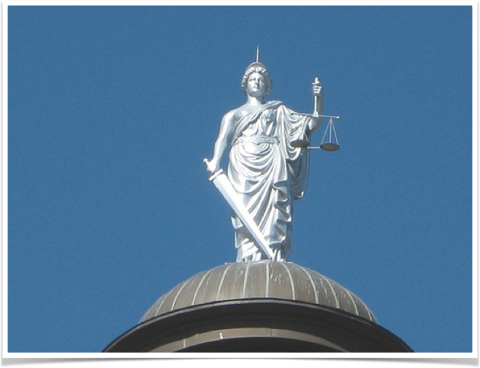
Doing Justice
An overview of the Three Components
of the Criminal Justice System

Slide 2
The Constitution of the United States
1. Establishes Authority for Government
2. Limits that Authority
3. Defines the rights of the People
4. Protects the rights of the People

Slide 3
The Three Components of the
Criminal Justice System
1. Law Enforcement
2. The Courts
3. Corrections

Slide 4
15 Steps Through The Justice System
The Three “Halls of Justice”
Law Enforcement
1. Contact
2. Investigation
3. Arrest
4. Custody
The Courts
5. Charging
6. Bail Considerations
7. Arraignment
8. Preliminary Hearing/Grand Jury
9. Plea Bargaining
10. Trial
11. Sentencing
12. Appeals/Post Conviction Remedies
Corrections
13. Correctional Treatment
14. Release
15. Post Release

Slide 5
The Law Enforcement Component
1. Contact with Law Enforcement
2. Subsequent Investigation
3. Arrest
4. Custody

Slide 6
The Law Enforcement Component
1. Contact with law Enforcement:
Contact reporting party or
Officer initiated (with reasonable suspicion or consent)
Determine if crime committed:
Initiate a crime report … or
Assist in official capacity:
(traffic, keep the peace,
delegate to civic services…)

Slide 7
The Law Enforcement Component
Interview Victim
Locate and interview Witnesses
Protect, Collect, and Document Evidence
Identify Suspects…
2. Subsequent Investigation:

Slide 8
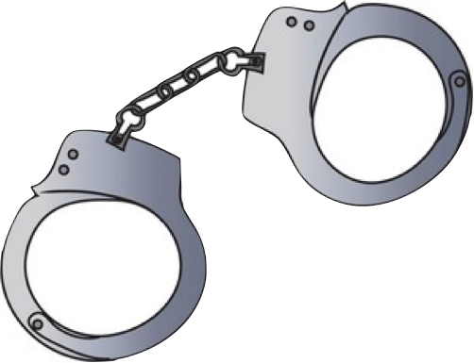
The Law Enforcement Component
Based on Probable Cause*
Secure a Warrant if needed
Cite and Release or
Transport to police station
Advise Suspect of charge
Advise Suspect of Miranda Rights if interrogated
3. Arrest:

Slide 9
The Law Enforcement Component
Complete Booking Process
Obtain booking number
Inventory prisoner property
Fingerprint and photograph
Check for wants and warrants
Advise of bail amount/possible O.R. release
4. Custody:

Slide 10
The Law Enforcement Component
The first 4 of the 15 steps belong in the
Law Enforcement Component.
1. Contact (Report of crime or officer initiated)
2. Investigation
3. Arrest
4. Custody
Next…. Off to Court System !
Review

Slide 11
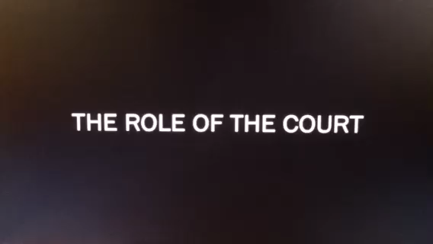
THE ROLE OF THE COURT

Slide 12
The Court Component
5. Charging
6. Bail Considerations
7. Arraignment
8. Preliminary Hearing / Grand Jury
9. Plea Bargaining
10. Trial
11. Sentencing
12. Appeals / Post Conviction Remedies

Slide 13
The Court Component
Law enforcement presents file to the prosecuting agency (District Attorney, or City Prosecutor)
Reviews reports, evidence, applies the facts to the law.
Case is Filed, Rejected or Returned for further investigation
If appropriate, the DA will file a “Complaint” to the court
5. Charging:

Slide 14
The Court Component
8th Amendment prohibits excessive bail, it does not guarantee bail.
Safety of community is main priority !
Purpose of Bail: To assure presence in court later
Assurance can also be qualified by “O.R” release
6. Bail / Detention:

Slide 15
The Court Component
Must happen within 48 hours *
Defendant advised of formal charges (not booking charges)
Defendant advised of rights
Attorney present, Public Defender provided (6th Amendment)
Defendant asked to enter plea (sentencing or trial follow)
Guilty, Not Guilty, Nolo Contendere.
Bail is addressed
….Preliminary Hearing is scheduled (based on plea)
7. Arraignment :

Slide 16
The Court Component
8. Preliminary Hearing / Grand Jury:
Two ways to accomplish the same thing:
Is there “Probable Cause” to continue ?
Either option: District Attorney must prove there is Probable Cause = “that a crime was committed and defendant was involved.”
Grand Jury: No Defendant and no Defense Attorney allowed. ***Intended to mimic the process a DA undertakes prior to filing a charge (no defendant there either !)
If Probable Cause is established … off to trial !

Slide 17
The Court Component
9. Plea Bargaining:
Defendant and DA attempt to reach an agreement to avoid a trial
Guilty plea for:
Reduced Sentence
Drop other counts
Diversion and/or jail not prison*
Most common practice in Court System (90% of cases)
Judge must agree to the deal. Can make his own offer*
Is it Justice?

Slide 18
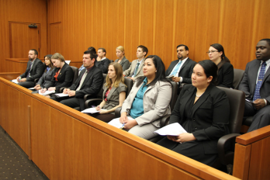
The Court Component
Pre-trial motions (anticipated issues)
Bench Trial: Judge Only
Jury Trial
Jury Selection
Jury Instructions
Verdict
Judgement
Sentencing hearing scheduled
10. Trial / Adjudication:

Slide 19
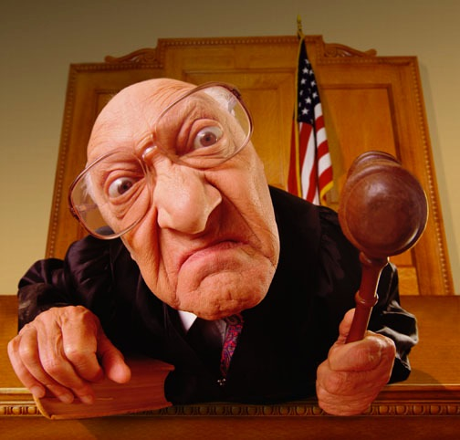
The Court Component
11. Sentencing / Disposition:
Judge Controls
Defendant’s past is now considered
Victim impact statement
Defendant Statement
Sentence Imposed:
Prison
Jail
Probation
Suspended

Slide 20
The Court Component
12. Appeal / Post Conviction Remedies:
”Take your court… to court “
Only Defense can appeal judgement
Appellate Court will review and decide to accept or not
Case facts assumed as true. Case is NOT retried
Appeals based on Constitutional Law issues ONLY
Due Process claims for:
Evidence issue, Jury Instruction flaw, misconduct
Must be “reversible error”
Judgement is: affirmed, reversed, or remanded.
Defendant can be retried.

Slide 21
The Court Component
Steps 5 - 12 occur in The Court Component
5. Charging
6. Bail Considerations
7. Arraignment
8. Preliminary Hearing / Grand Jury
9. Plea Bargaining
10. Trial
11. Sentencing
12. Appeals / Post Conviction Remedies
Review

Slide 22
The Corrections Component
Correctional Treatment
Ranges from:
Death Penalty to…
Restorative Justice
Release/Transitions
Post Incarceration Release

Slide 23
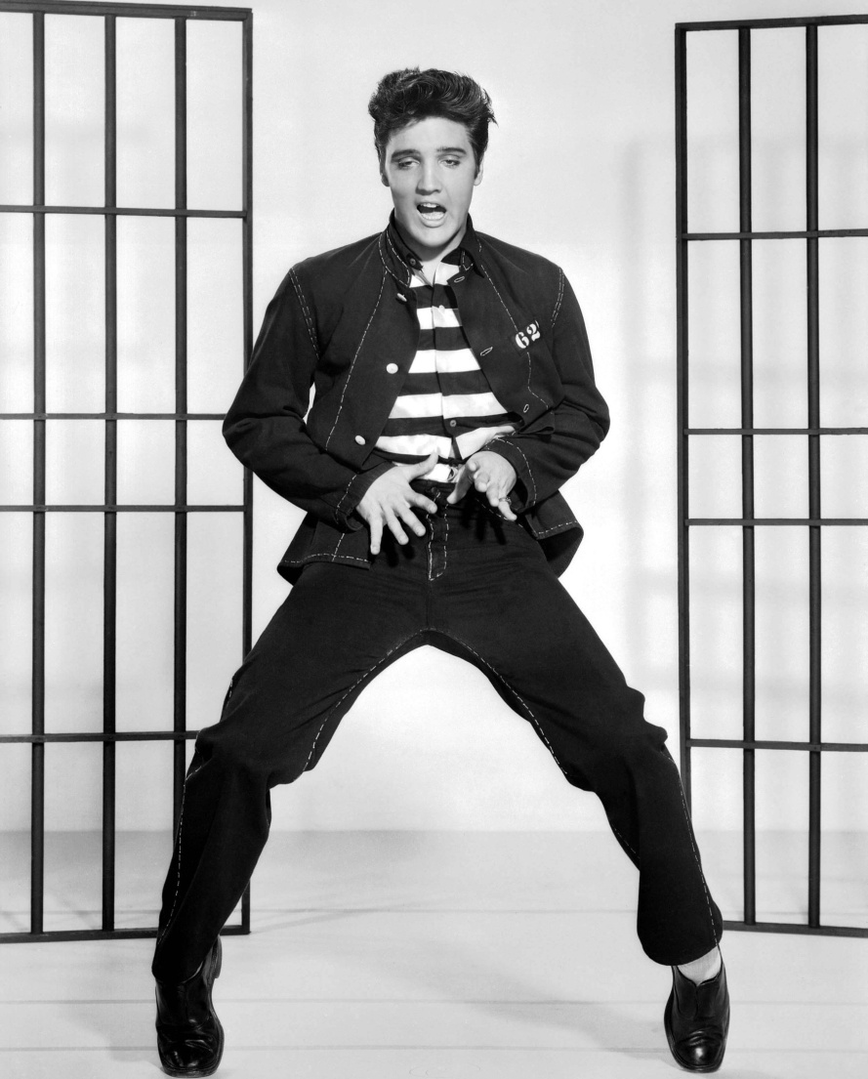
The Corrections Component
13. Correctional Treatment:
Punishment, but also
Rehabilitation Programs
Drugs
Alcohol
Emotional
Opportunities to Thrive
Academics
Trades
Personalized Probations
Restorative Justice
Avoid Stigma Cycle

Slide 24
The Corrections Component
If Incarcerated…
Parole / Probation
Early Release
Full Sentence Served
14. Release :

Slide 25
The Corrections Component
State Parole
First serve required % of time correctly
Parole Board reviews and evaluates behavior
Granted or Denied at official hearings
If granted, still under State control *
County Probation
Half Way House
Community Service/involvement
When Obligations fulfilled =
15. Post Release :

Slide 26
15 Steps Through The Justice System
Review
Law Enforcement
1. Contact
2. Investigation
3. Arrest
4. Custody
The Courts
5. Charging
6. Bail Considerations
7. Arraignment
8. Preliminary Hearing/Grand Jury
9. Plea Bargaining
10. Trial
11. Sentencing
12. Appeals/Post Conviction Remedies
Corrections
13. Correctional Treatment
14. Release
15. Post Release

